Slide 1
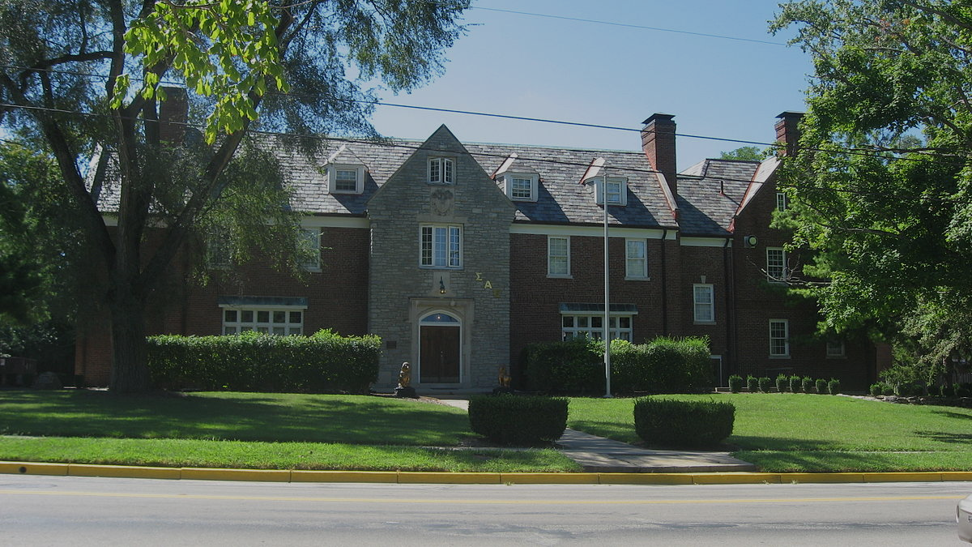
∑AE New Member Program

Slide 2
Hazing Policy
“SAE has a zero tolerance policy for hazing and has taken a strong stance against any kind of hazing activity whether alcohol is involved or not. As well, hazing has long since been banned from fraternities as an illegal practice. This outdated practice has greater negative effects than, if any, positive ones. Any incidents involving the physical or mental mistreatment of a member of the fraternity will be not be tolerated and those involved will face disciplinary measures. Groups should place emphasis on a program that prepares men to be active during their total college career rather than one that emphasizes the new member process. It is the belief of the fraternity that the difference in status between a new member and an active collegiate member is negligible. Below is a collection of resources to combat hazing as well as Miami Universities hazing policy found in the Code of Student Conduct.”
As Stated in Final EME Document

Slide 3
Anti-Hazing Internal Steps
Members who are accused will face suspension or probation and no longer be welcomed at SAE social events or new member ceremonies
Chapter house
- Outlined expectations to Dean (live in advisor)
Annex houses
- Appointed leaders to oversee activities and relationships

Slide 4
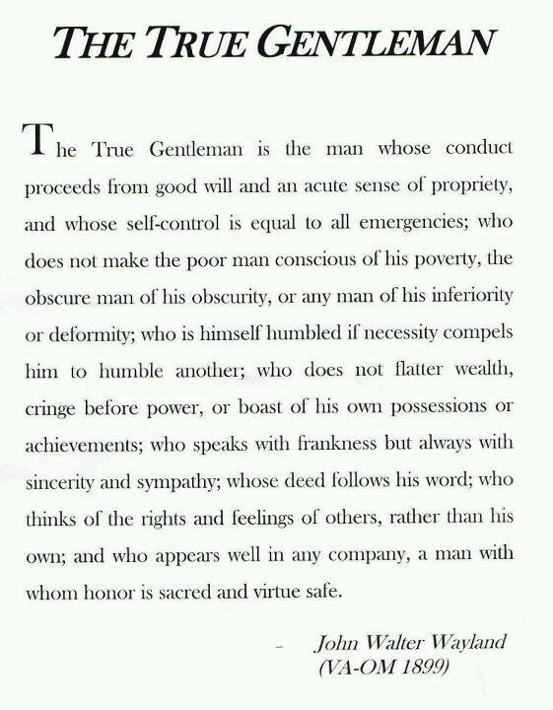
Week 1 – The True Gentleman Introduction
Interpretations of the TG
Evidence of TG qualities in real life
Discussion of ways to incorporate the TG into our lives

Slide 5
Week 2 – Focus on Intellectual, Relational, & Leadership Growth
Intellectual:
● Attain a 3.0 GPA for the semester/year (no less than 2.5)
● Mentoring or being mentored by people in your area of study
● Developing disciplined study practices (time and regularity)
● Taking time to read and learn/reading on a subject that interests you
● Develop problem solving and critical thinking skills
Relational:
● Take time to get to know all the brothers and some alumni
● Learn to effectively handle conflict
● Understand what kind of relationships you want to be in
● Learning to become a better recruiter
● Being able to hold your own opinion, not being a people pleaser
● Being self-dependent “being comfortable in your own skin”
Leadership:
● Taking on/running for a leadership position within SAE
● Being part of the leadership fabric of another organization
● Develop a program or add to a program for the chapter
● Pursue a conversation with someone who you consider a leader on campus to understand what makes a person an effective leader
● Take time to read and study a book or seminar on leadership
● Learning to diversify your involvement and skills within the fraternity

Slide 6
Week 3 – History and Becoming a True Gentleman
● Learning and being aware of how you respond under pressure
● Being aware of how you view and judge other people
● Making yourself available to guys who are in need
● Be willing to take on new responsibilities
● Becoming confident in what you are saying through actions, beliefs, and reasoning, while being aware of the opinions of others
● Becoming a man of integrity (word matches deeds)
● Becoming more aware of what others think and feel
● Growing in your ability to represent SAE
● Growing in your ability to be an honest, trustworthy, and safe person

Slide 7
Week 4 – Focus on Physical & Lifestyle Growth
● Toss bad habits or addictions (smoking, eating habits)
● Learning and practicing good hygiene
● Good grooming habits, making yourself well presentable
● Learning good etiquette
● Common chivalrous behavior
● Healthy exercise habits or sleep patterns
● Learning how to drive a manual car
● Learning to achieve balance in your life

Slide 8
Questions?

